Slide 1

Python Operators
PY
Python Is FUN

Slide 2

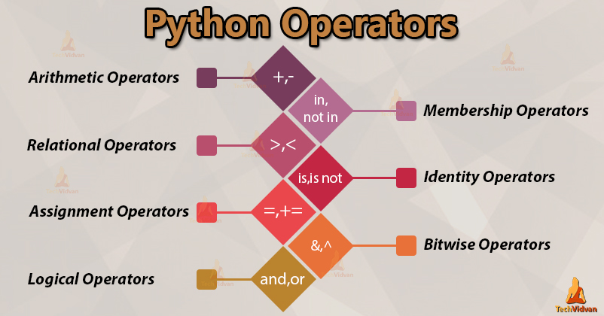
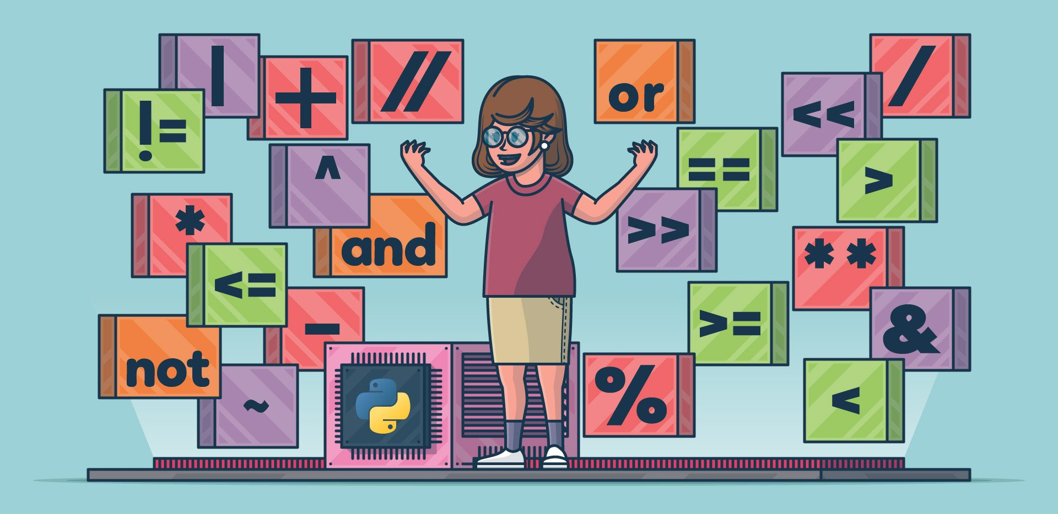
What is operators?
The operator can be defined as a symbol which is responsible for a particular operation between two operands.
Operators are the pillars of a program on which the logic is built in a specific programming language.

Slide 3
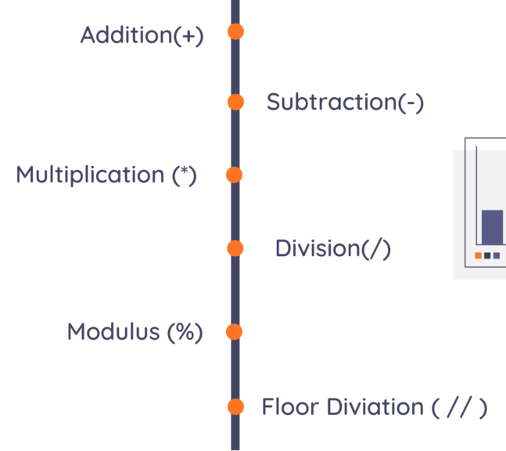
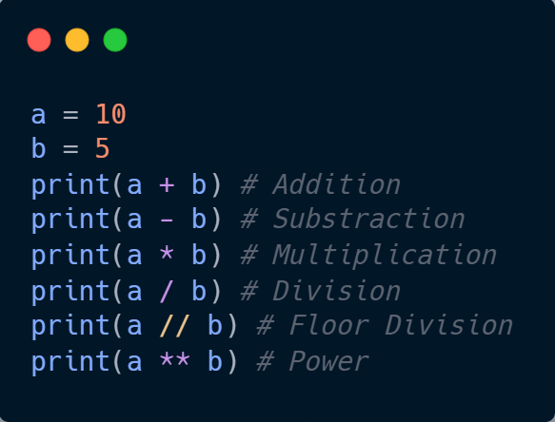
1. Arithmetic Operator
Arithmetic operators are used to perform arithmetic operations between two operands.

Slide 4
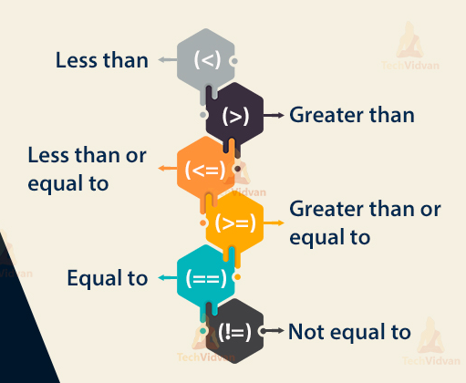
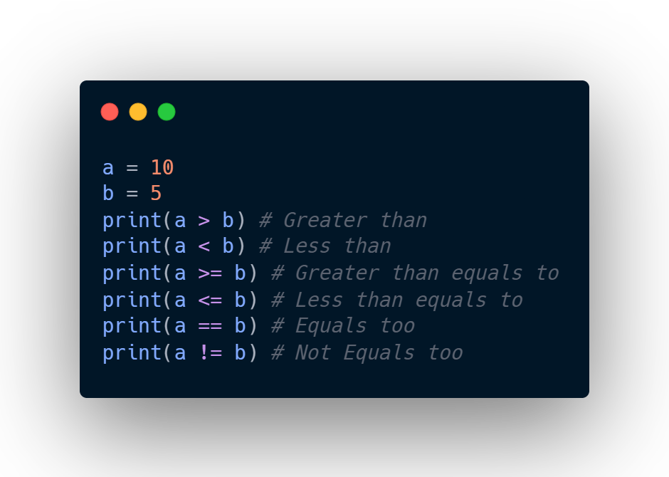
2. Comparison operators
Comparison operators are used to comparing the value of the two operands and returns Boolean true or false accordingly.

Slide 5
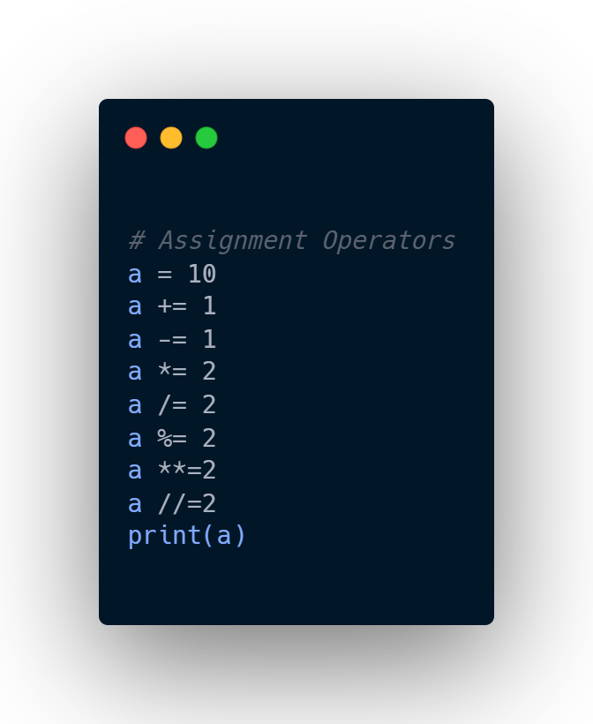
3. Assignment Operators
The assignment operators are used to assign the value of the right expression to the left operand.

Slide 6
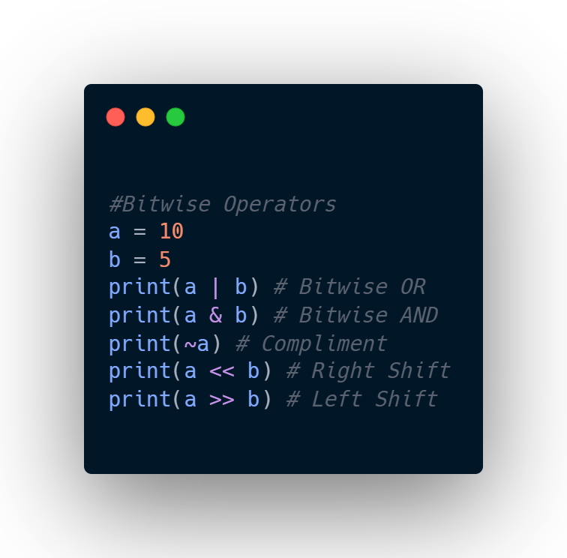
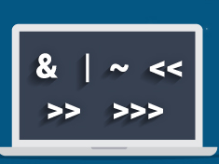
4. Bitwise Operators
The bitwise operators perform bit by bit operation on the values of the two operands.

Slide 7
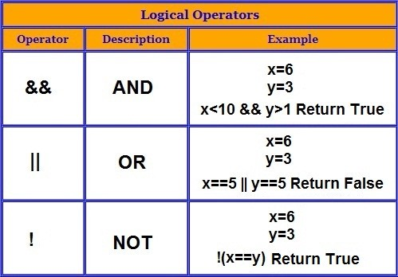
5. Logical Operators
The logical operators are used primarily in the expression evaluation to make a decision.

Slide 8
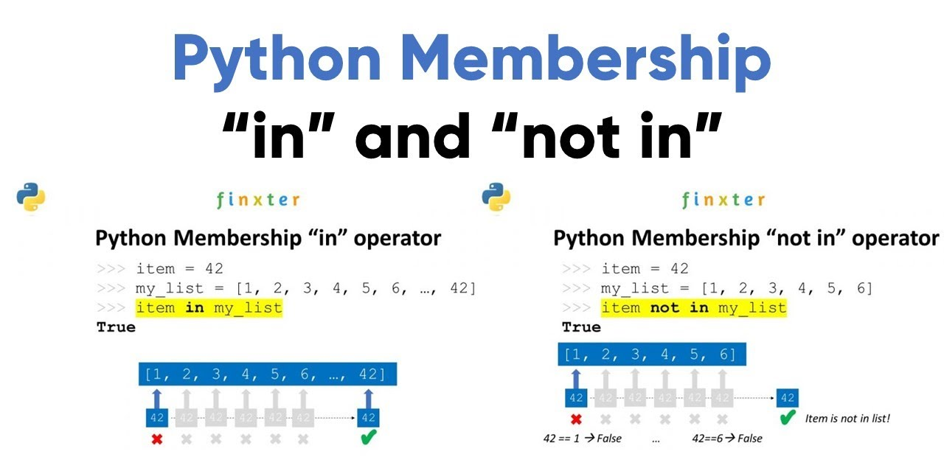
6. Membership Operators
Python membership operators are used to check the membership of value inside a Python data structure.

Slide 9
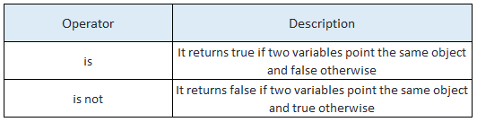
7. Identity Operators
The identity operators are used to decide whether an element certain class or type.

Slide 10
Thank You
PY
Python Is FUN
- By Vinit

